Slide 1



Knowledge Discovery from
Natural Language Text
Dr Wei Liu
Tyler Bikaun
wei.liu@uwa.edu.au
tyler.bikaun@research.uwa.edu.au
Computer Science and Software Engineering

Slide 2
Outline
Text Mining
Information Extraction
Word Embeddings
Topic Modelling
Sentiment Detection
Knowledge Representation
Machine Learning
Computational Linguistic

Slide 3
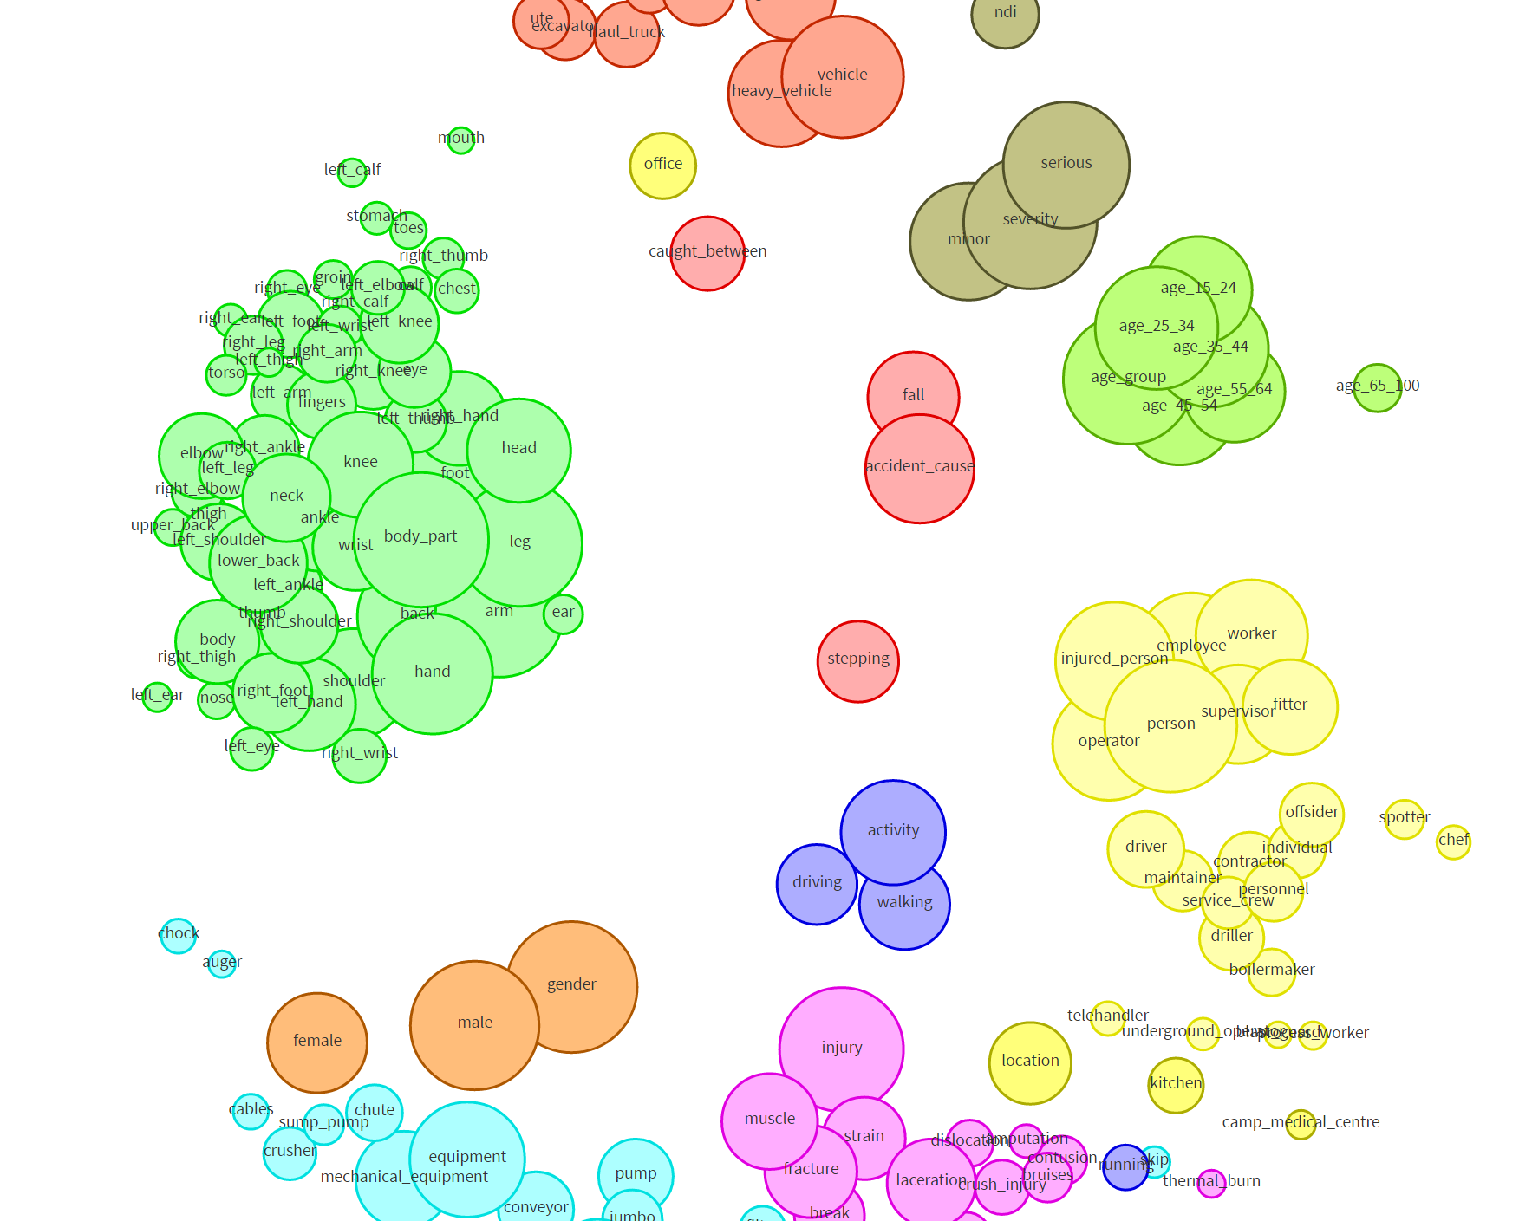
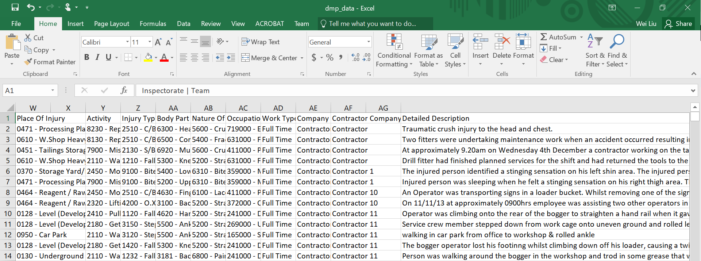
Extracting Semantics – Association Rule Mining
Text Mining - http://agent.csse.uwa.edu.au/aquila

Slide 4
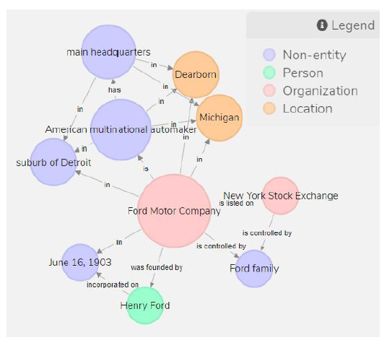
Extracting Semantic – Knowledge Graph Construction from Text
Ford Motor Company is an American multinational automaker that has its main headquarters in Dearborn, Michigan, a suburb of Detroit. The company was founded by Henry Ford and incorporated on June 16, 1903. The company is listed on the New York Stock Exchange and it is controlled by the Ford
family.
Ford Motor Company is an American multinational automaker that has its main headquarters in Dearborn, Michigan, a suburb of Detroit. The company was founded by Henry Ford and incorporated on June 16, 1903. The company is listed on the New York Stock Exchange and it
is controlled by the Ford
family.
Knowledge Graph Construction from Text - http://agent.csse.uwa.edu.au/text2kg

Slide 5
Extracting “Social” Relations between words
Kalgoorlie + iron-ore –gold = ???

Slide 6
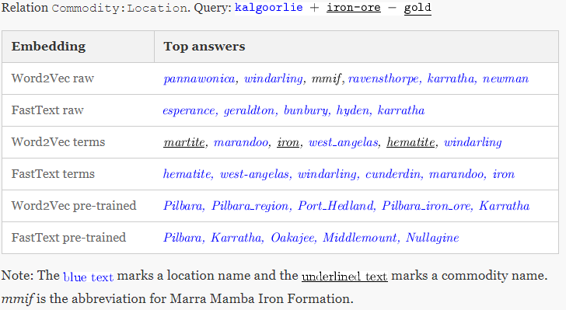
Extracting “Social” Relations between words

Slide 7
Extracting Sentiment from Text

Slide 8
Extracting Sentiment from Text
Dow Jones
CALM
Johan Bollen, Huina Mao, Xiaojun Zeng. 2011. Twitter mood predicts the stock market,
Journal of Computational Science 2:1, 1-8. 10.1016/j.jocs.2010.12.007.
Notes:
Up to here ~30min.

Slide 9
12.1 text mining
Week 12 Natural Language Processing

Slide 10
Outline
Graphs in knowledge representation
Two different sources
Knowledge experts (logic based)
Knowledge discovery (from natural language texts)
Ontology learning
Entity Extraction
Symbolic
Unsupervised learning
Supervised learning
Subsymbolic
Deep learning
Entity Relation Extraction
Knowledge Representation
Machine Learning
Computational Linguistic

Slide 11
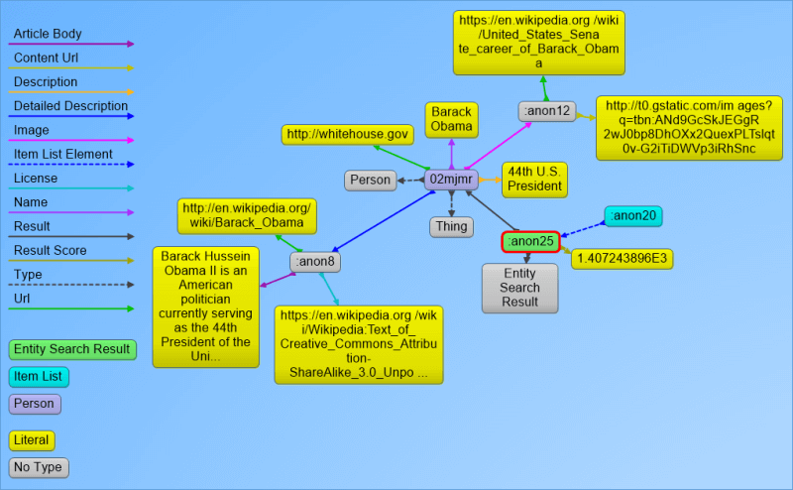
Knowledge Graph and Linked Data
Used by Google for semantic-enriched information retrieval with a knowledge base gathered from a wide variety of sources, such as Freebase.
Knowledge Graph display was added to Google's search engine in 2012, starting in the United States.
Getting a ranked list of the most notable entities that match certain criteria.
Predictively completing entities in a search box.
Annotating/organizing content using the Knowledge Graph entities.
http://searchengineland.com/laymans-visual-guide-googles-knowledge-graph-search-api-241935

Slide 12
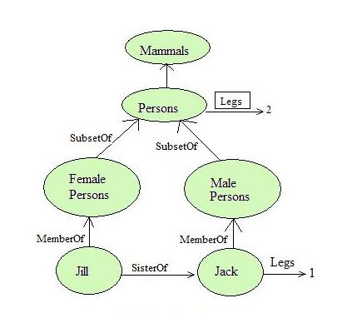
Semantic Networks (Masterman 1961)
Also known as propositional net.
Representing propositional knowledge.
Mathematically can be defined as a labelled directed graph.
Nodes represent objects such as physical objects, concepts or situations.
Links express the relationships between objects, and link labels specify particular relations.
As nodes are associated with other nodes semantic nets are also referred to as associative nets.
http://intelligence.worldofcomputing.net/knowledge-representation/semantic-nets.html#.WODyYvmGPD4

Slide 13
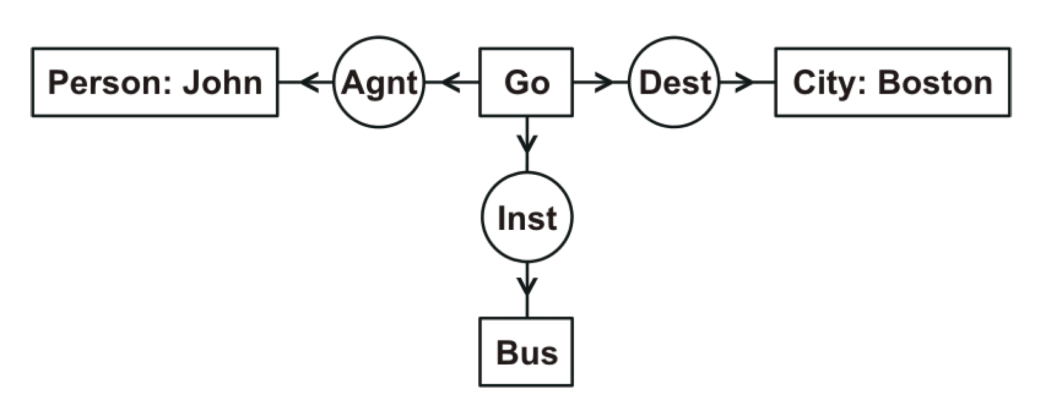
Conceptual Graph and others (Sowa)
Early graph notations represented the relational structures underlying natural language semantics, but none of them could express full first-order logic.
correlational nets, which were based on 56 different relations, including subtype, instance, part-whole, case relations, kinship relations, and various kinds of attributes (Silvio Ceccato); and
dependency graphs (David Hays), which formalized the notation developed by the linguist Lucien Tesniere (1959).
In the late 1970s, many graph notations were designed to represent first-order logic or a formally defined subset (Findler 1979)
Conceptual Graph* (Sowa 1976) is an intermediate language for mapping natural language questions and assertions to a relational database.
* http://www.jfsowa.com/cg/cg_hbook.pdf

Slide 14
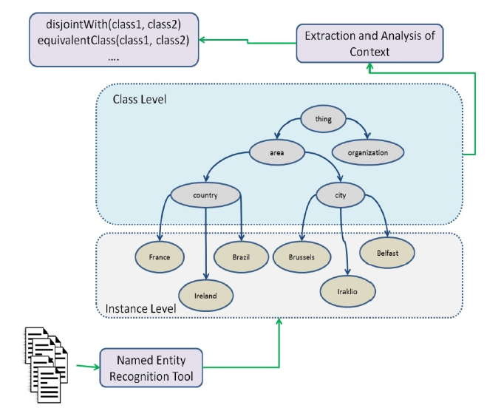
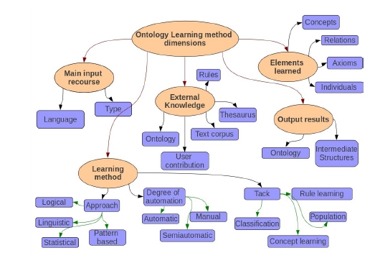
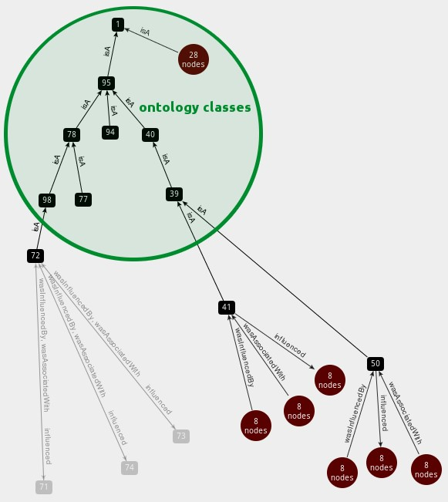
Knowledge Graph Construction (a.k.a. Ontology Learning)
https://neo4j.com/blog/using-owl-with-neo4j/
Ana Rios-Alvarado and Ivan Lopez-Arevalo (Technical Report, 2012): Ontology learning from text: Method for learning axioms

Slide 15
text > sets of corpora are prepared for ontology construction. Web Crawling is performed to gather web pages from general sources such as Reuters, Discovery and CNet to create the Contrastive Corpus. Readily available non-domain specific
Lightweight Ontologies
Text Preprocessing
texts
Text Processing
term candidates
Term Recognition
terms
Relation Acquisition
parse HTML/XML files for texts.
segment texts to identify sentences.
remove noise.
parse sentences for part-of-speech and grammatical information.
extract noun phrases as term candidates and measure their collocational strength (i.e. unithood).
determine the relevance of term candidates with respect to a domain (i.e. termhood) using text corpora.
acquire semantic relations between terms.
[University of WA]
[education]
[next year]
[Perth]
…
How is [University of WA] related to [education]
...University of WA… universities of Perth...
...[University of WA]…[universities] of [Perth]….

Slide 16
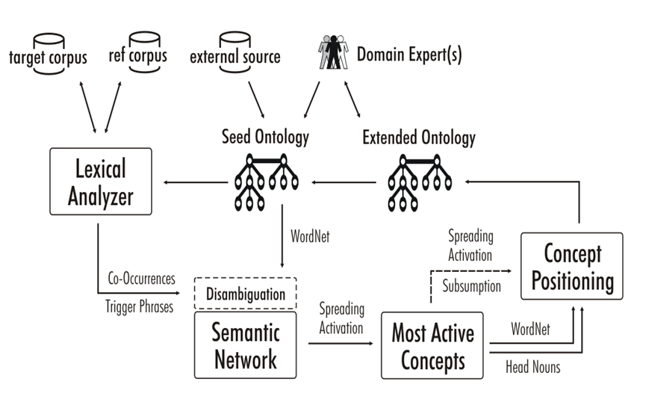
A semi-automatic ontology learning system
Wei Liu, Arno Scharl & Albert Weischselbraun, 2005
Notes:
Subsumption: For a word pair (A, B) that are connected, if whenever word A occurs, word B also occur, but not the other way round, in other words, P(A)<P(B), then A is a subclass of B, or B is the super class.

Slide 17
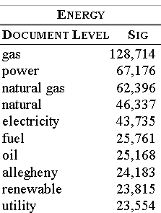
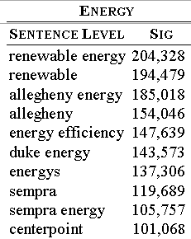
Results of climate change data analysis

Slide 18
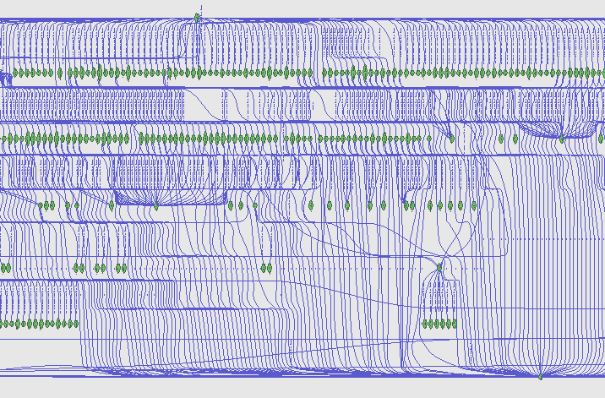
Semantic Network Visualisation

Slide 19
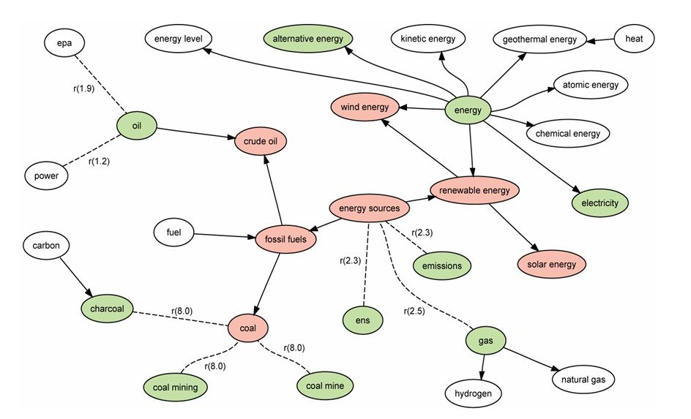
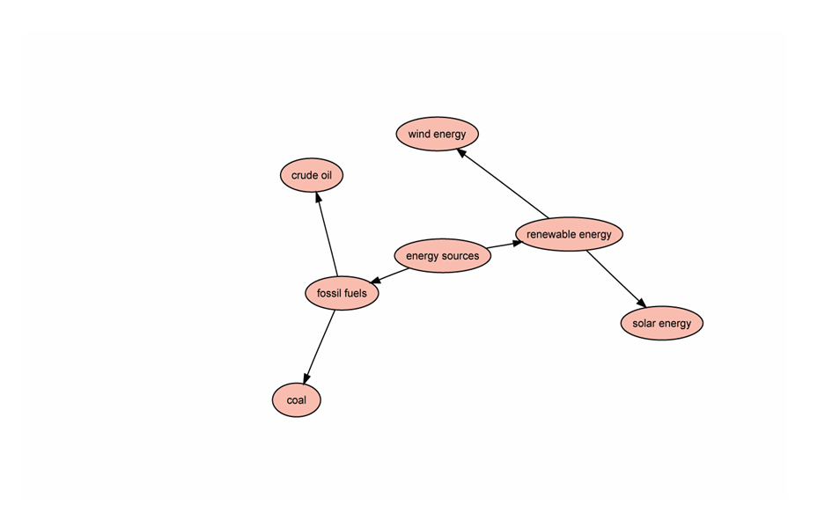
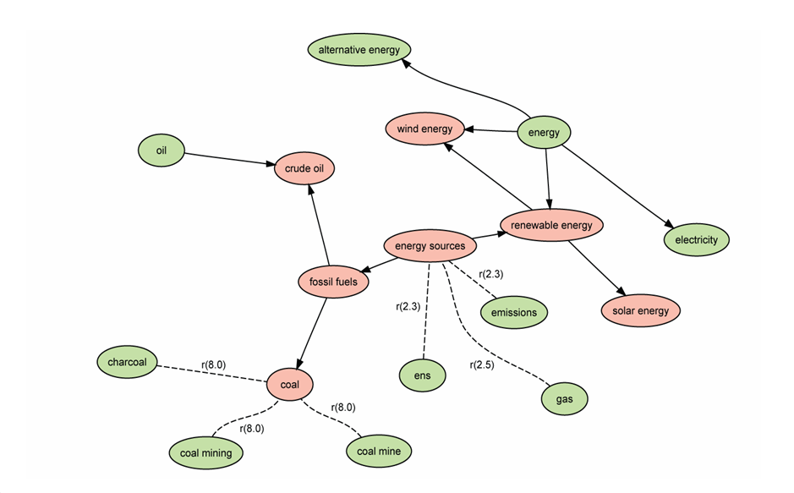
Spreading Activation

Slide 20
Knowledge Graph Construction From Text
A knowledge graph (KG) is a graph-structured knowledge base that stores knowledge in the form of the relation between entities.
Subtasks of Knowledge Graph Construction
Entity Extraction
Relation Extraction
Axiom Extraction
Note that we do not attempt to link to an existing KG such as Freebase, DBPedia, YAGO, and NELL.

Slide 21
text > sets of corpora are prepared for ontology construction. Web Crawling is performed to gather web pages from general sources such as Reuters, Discovery and CNet to create the Contrastive Corpus. Readily available non-domain specific
Lightweight Ontologies
Text Preprocessing
texts
Text Processing
term candidates
Term Recognition
terms
Relation Acquisition
parse HTML/XML files for texts.
segment texts to identify sentences.
remove noise.
parse sentences for part-of-speech and grammatical information.
extract noun phrases as term candidates and measure their collocational strength (i.e. unithood).
determine the relevance of term candidates with respect to a domain (i.e. termhood) using text corpora.
acquire semantic relations between terms.
[University of WA]
[education]
[next year]
[Perth]
…
How is [University of WA] related to [education]
...University of WA… universities of Perth...
...[University of WA]…[universities] of [Perth]….

Slide 22
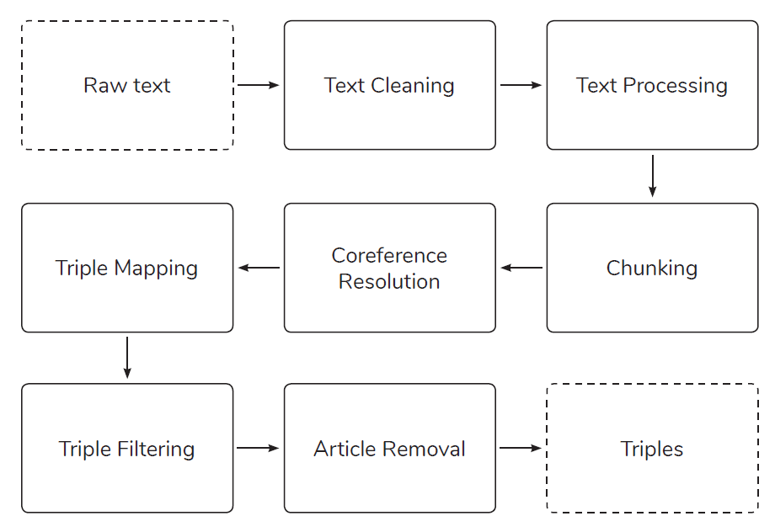
ICDM Knowledge Graph Contest 2019
M. Stewart, M. Enkhsaikhan and W. Liu, "ICDM 2019 Knowledge Graph Contest: Team UWA," 2019 IEEE International Conference on Data Mining (ICDM), Beijing, China, 2019, pp. 1546-1551.

Slide 23
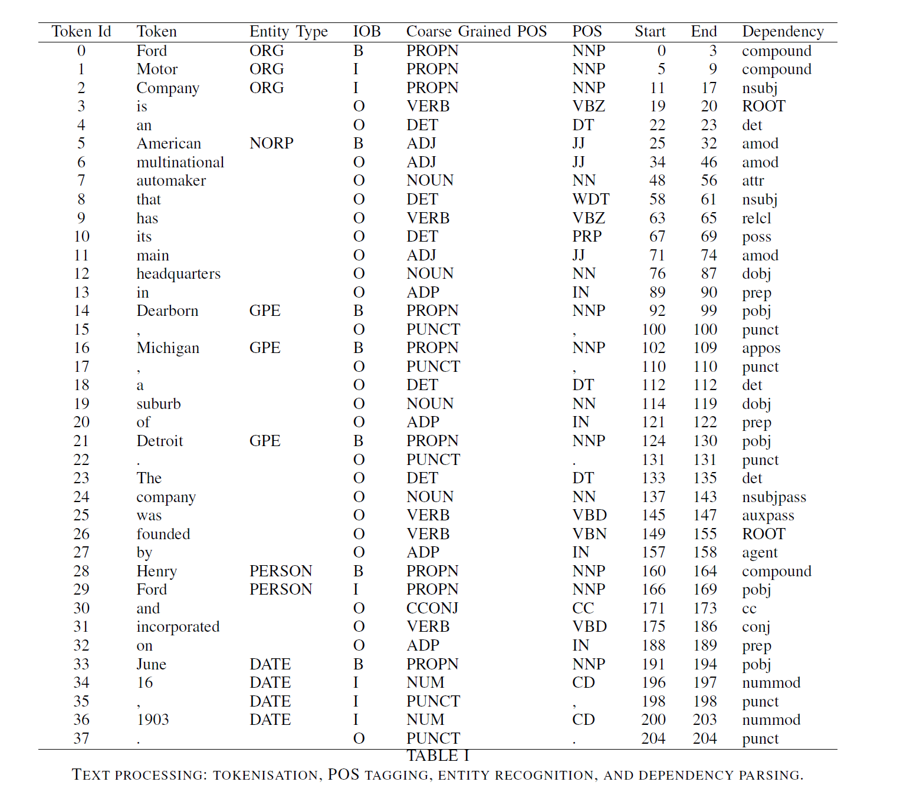
Text Cleaning and Text Processing
Text Cleaning: special
characters such as hyphen and quotation marks and also break
sentences joined together with no space between them.
Text processing: The text is processed through tokenisation,
POS tagging, entity recognition and dependency parsing
steps using SpaCy.

Slide 24
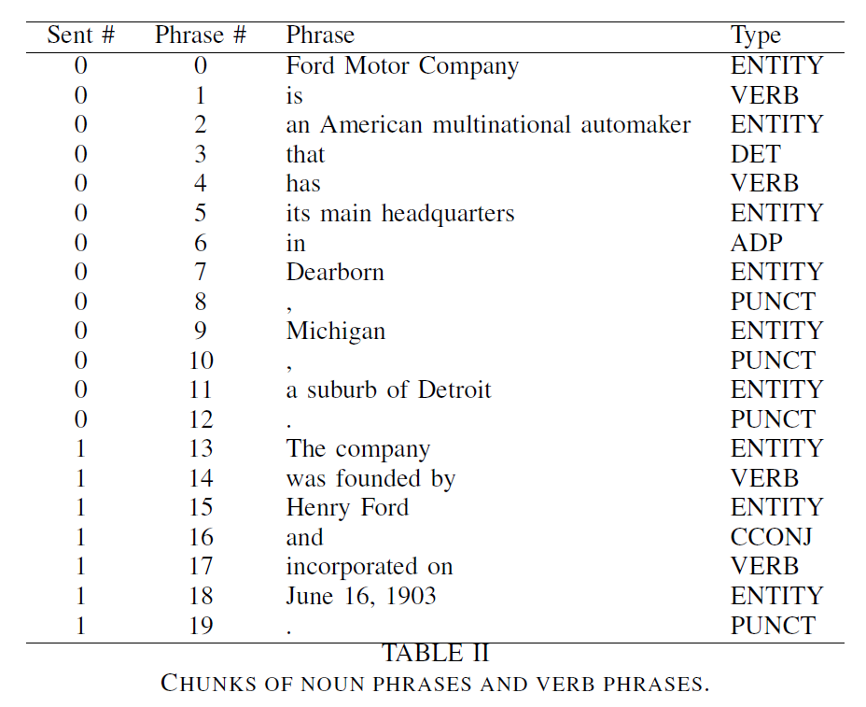
Phrase Identification – Linguistic Rules
Noun Phrase Chunking:
NP
(NP)
NP + of + NP
NP + NP
Verb Phrase Chunking:
VERB + PART
VERB + ADP
ADP + VERB
PART + VERB11ERB

Slide 25
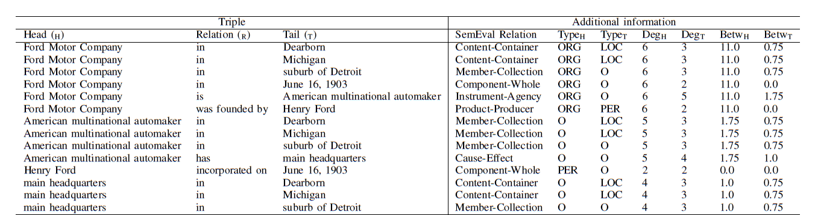
Triple Creation and Filtering
COREF Resolution *:
Coreference items are resolved by replacing the original phrase with the referred phrase for each item.
Triple Creation: Find triples in the same sentence by finding entities before and after verb phrases;
Document-level triples are obtained by finding shortest path between any pair of entities.
Triple Filtering: remove any triple with a stop word as a head entity. The stop words include NLTK stop words,
names of days (e.g. Monday) and names of months (e.g. January).
Article Removal: articles (a, an, the), possessive pronouns
(e.g., its, their) and demonstrative pronouns (e.g., that, these) are removed from the heads and tails.
*NeuralCoref https://github.com/huggingface/neuralcoref

Slide 26
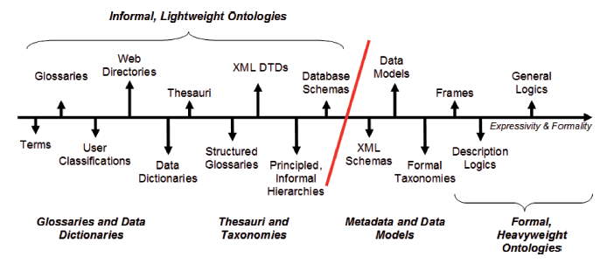

Overview – What’s Light Weight Ontology
Ontologies are formal and explicit specification in the form of concepts and relations of shared conceputalisation [Gruber 1993].
Indispensible for unambiguous communication and interoperation of autonomous entities.
Wilson Wong, Wei Liu, and Mohammed Bennamoun. (2012) Ontology Learning from Text: A look back and into the future, ACM COMPUTING SURVEYS, 44, 4, Article 20, pp. 20:1-20:36
Notes:
Up to here ~30min
NLTK notebook to get familiarity with tools and text processing (Tyler to run Wei to assist)

Slide 27
12.2 Word embeddings
Week 12 Natural Language Processing
Notes:
Get everyone to open up notebooks here before getting into material.
Notebooks Gensim word vectors (intro, analogies, etc.) & Word Embeddings (domain-specific)

Slide 28
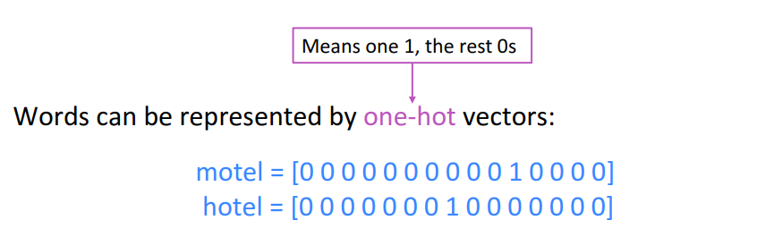
Word representations – one hot vectors
(Socher, 2018)
Notes:
How do we represent words?
One hot encoding (count vectorising); basic, naïve.
Vector dimension becomes as large as the number of words in the vocabulary. This is not ideal for large ML systems.
Socher, R. (2018, January 18). Natural Language Processing with Deep Learning CS224N/Ling284 [PowerPoint slides]. https://web.stanford.edu/class/archive/cs/cs224n/cs224n.1184/lectures/lecture2.pdf

Slide 29
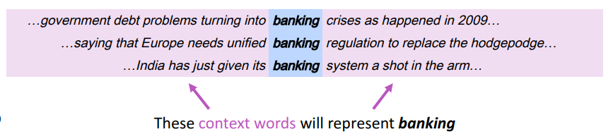
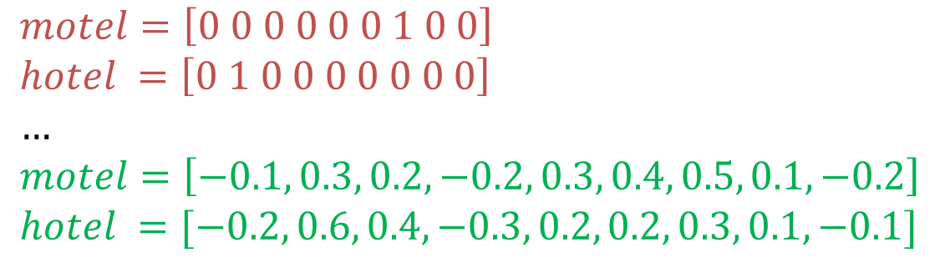
Representing words by their context
One
Hot
$$motel=\left[0 0 0 0 0 0 1 0 0\right] \\ hotel =\left[0 1 0 0 0 0 0 0 0\right] \\ … \\ motel=\left[−0.1, 0.3, 0.2, −0.2, 0.3, 0.4, 0.5, 0.1, −0.2\right] \\ hotel =[−0.2, 0.6, 0.4, −0.3, 0.2, 0.2, 0.3, 0.1, −0.1]$$
Word Embeddings
(Socher, 2018)
Notes:
How do we capture semantic and syntactic similarities, relationships with other words, etc.
“You shall know a word by the company it keeps” (J. R. Firth 1957: 11)
Distribution representations of words; that is, we want to introduce dependence between words. We are unable to determine similarity between one hot vectors because they’re orthogonal e.g. their dot product is zero.
Socher, R. (2018, January 18). Natural Language Processing with Deep Learning CS224N/Ling284 [PowerPoint slides]. https://web.stanford.edu/class/archive/cs/cs224n/cs224n.1184/lectures/lecture2.pdf

Slide 30

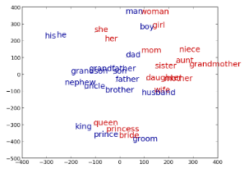
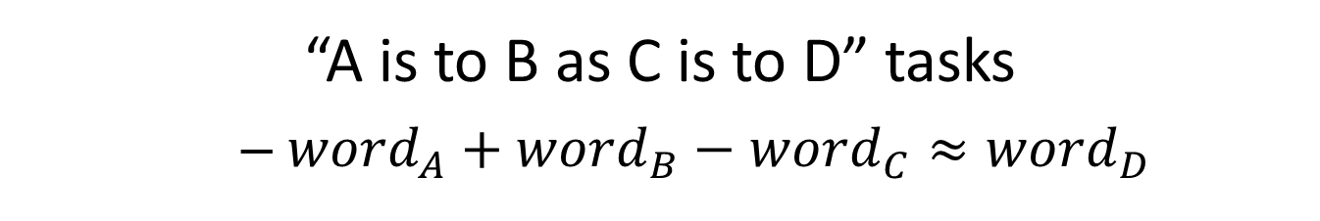
Imagine doing simple math with words
“A is to B as C is to D” tasks
${word}_{A}+{word}_{B}−{word}_{C}≈{word}_{D}$
See: http://rare-technologies.com/word2vec-tutorial/ for word2vec application.
Notes:
Word analogies. For example: King – Man + Queen = Female
Similarity -> distance; relationship between words -> angle (the same relationship has the same angle).

Slide 31
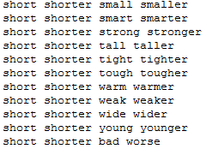
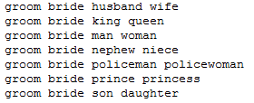
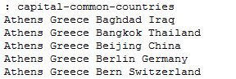
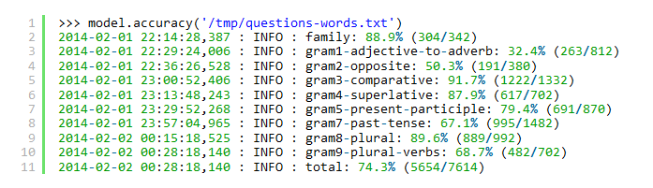
“A is to B as C is to D” tasks
Notes:
20,000 syntactic and semantic test examples (Google)
The top 30,000 words ranked according to frequency are used for the evaluation shown.

Slide 32
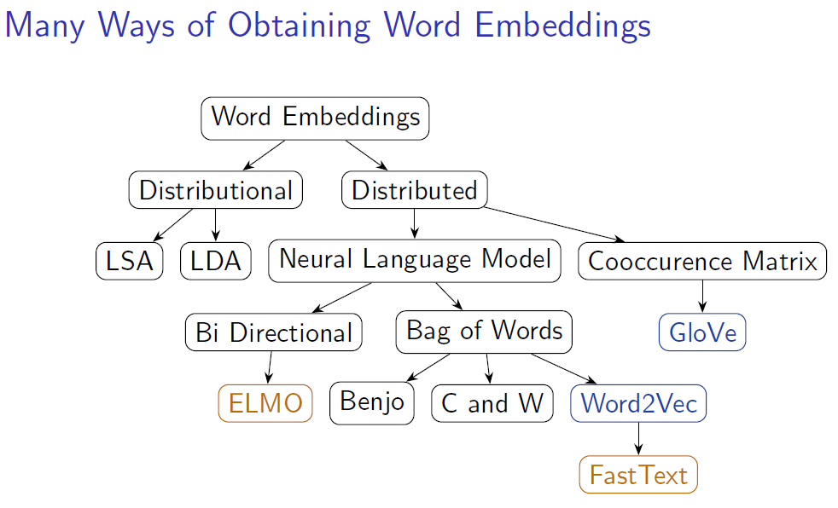
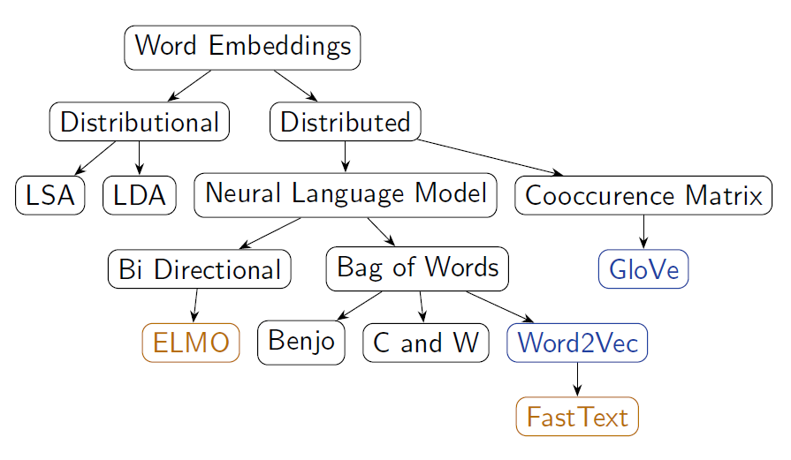
Many ways of obtaining word vectors
Notes:
Word2Vec (neural embedding model); ‘self-supervised’
1. one-word context (predicting one word given only one word); referred to as a continuous bag of words (CBOW) model. Input is a onehot encoded vector
2. multi-word context (similar to one-word but we need in multiple words)
3. Skip-gram model (opposite to CBOW multi-word). Given word w predict n words surrounding it (windowing).
GloVe (Global Vectors for Word Representation)-> captures the meaning of a word embedding with the structure of the entire observed corpus. This model utilises word frequencies and co-occurrence counts in a unsupervised manner.
ELMO (Embeddings from Language Models)-> Context-dependent embeddings; uses language models to capture embeddings for individual words while conditioning on the entire sentence or document. Conventional embeddings have issues with polysemy e.g. “the bank on the other end of the street was robbed” vs. “we had a picnic by the bank on the river”. Many embedding models find it difficult to distinguish the difference between the use of the word bank. Elmo captures this meaning by conditioning on the context it’s in and the word vector changes based on the words around it.

Slide 33
Word2Vec (Mikolov et al. 2013)
For learning word representations.
Using a shallow neural network, no hidden layer.
No shared parameters across the network.
Fast training – training over Wikipedia snapshot (about 1 billion words) with 50 dimensions takes only 4 hours.
State-of-the-art performance. Learned word embedding vectors can be represented as linear translations, e.g.
Notes:
One of the most popular techniques for learning embeddings.
No activations on the central layer, just a weighted sum of the inputs.

Slide 34
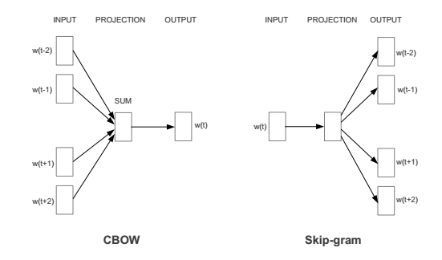
Word2Vec (Cont.)
Word2vec has two models, Continuous Bag of Word (CBOW) and SkipGram models.
CBOW: predicting w_{t} given its context
SkipGram: predicting the context words given a word w_{t}
[Image credits: Mikolov et al (2013) “Efficient estimation of word representations in vector space”]
Notes:
Continuous bag of words (CBOW); takes in a group (or a singular word) of context words and tries to predict the corresponding word; each of the inputs are represented as one-hot vectors.
Skip-gram; takes in an input word and tries to output n probability distributions (based on a given window size). Each word gets a distribution across the entire vocab.
Skip-gram typically words better with small datasets and rare words whereas CBOW works better with larger datasets with more frequent words. CBOW is also faster than skip-gram.

Slide 35
From Word and Phrases to Sentence Representations
martial [ 0.12657, 0.61425, … , 0.86142]
art [ 0.71089, 0.21725, … , 0.39198]
martial art [ 0.46352, 0.48576, … , 0.09812]
I am learning martial arts [ 0.23242, 0.09824, … , 0.97242]
I am in kongfu training [ 0.21141, 0.08576, … , 0.99812]
I am in kongfu training
I am learning martial arts
army
military
martial
martial art
art
kongfu
craft
Taekwondo
technique
Notes:
X

Slide 36
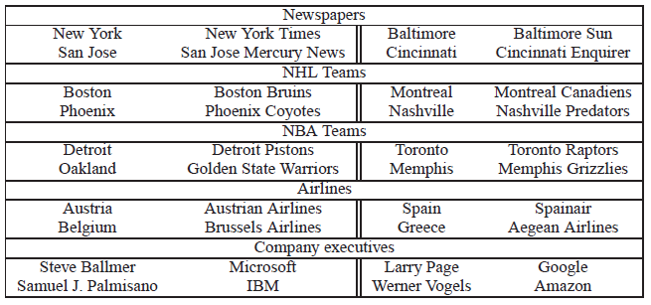
Holistic Approach
Treating phrases in the same way as individual words by using a pre-identified phrase list (Mikolov et al. 2013) .
Using word2vec to train both word and phrase embeddings, achieved 72% accuracy on phrase analogy tests.
Problem:
Suffering from data sparsity, not generating phrases that are not in the pre-identified list or not occur in the training set.

Slide 37
Our Approach - MVRU
Unsupervised phrase representation learning.
Phrases are pre-identified.
Combining SkipGram prediction model with the Matrix-Vector Recursive/LSTM/GRU models
A function g that computes the compositional semantic representation of phrases
A function f that maps the conditional probability distribution of phrases over a corpus
John bought a built by HP
predicts
SkipGram Model
phrase vector representation
LSTM/GRU
MVRNN
(p₁, P₁)
v_{a}
v_{b}
v_{c}
(v_{a}, M_{a})
(v_{b}, M_{b})
(v_{c}, M_{c})
a = fast
b = laptop
c = computer
Rui Wang, Wei Liu, and Chris McDonald. 2017. A Matrix-Vector Recurrent Unit Model for Capturing Compositional Semantics in Phrase Embeddings. In Proceedings of the 2017 ACM on Conference on Information and Knowledge Management (CIKM '17). ACM, New York, NY, USA, 1499-1507.

Slide 38
12.3 Topic modelling
Week 12 Natural Language Processing

Slide 39
Topic Modelling
Suppose you have the following set of sentences:
I eat fish and vegetables.
Fish are pets.
My kitten eats fish.
Latent Dirichlet allocation (LDA) is a technique that automatically discovers topics that these documents contain.
bold words under the Topic F, which we might label as “food“.
italics words might be classified under a separate Topic P, which we might label as “pets“.
https://www.quora.com/What-is-the-best-way-to-explain-topic-modeling-to-a-layman

Slide 40
Topic Modelling
Suppose you have the following set of sentences:
I eat fish and vegetables.
Fish are pets.
My kitten eats fish.
Latent Dirichlet allocation (LDA) is a technique that automatically discovers topics that these documents contain.
bold words under the Topic F, which we might label as “food“.
italics words might be classified under a separate Topic P, which we might label as “pets“.
Notes:
.. therefore we are (1) intensive skills pilot programs to bring new opportunities to market supporting individuals and organisations – and (2) a community of practice
Proactive stance – have impact or be impacted
Industry is supporting us – share knowledge, data, case studies – they recognise the imperative
Can’t predict the future but can be prepared
Profound advances - disrupting old ways of working and enabling step changes in productivity. Jobs, including knowledge work, are being replaced by automation at scale, and those remaining require increased human–machine interaction.
Data generation continues to grow exponentially, as every piece of equipment connects. This explosion of data—combined with analytics and machine learning—creates opportunities
means great improvements in workforce productivity. E.g. advanced analytics -sift through 1000s of capital projects - isolate a few simple measures that improved engineering productivity >20%.

Slide 41
^{Topic Modelling}
LDA defines each topic as a bag of words, and you have to label the topics as you deem fit.
We can infer the content spread of each sentence by a word count: Sentence 1: 100% Topic F Sentence 2: 100% Topic P Sentence 3: 33% Topic P and 67% Topic F
We can derive the proportions that each word constitutes in given topics. For example, Topic F might comprise words in the following proportions: 40% eat, 40% fish, 20% vegetables, …
Notes:
.. therefore we are (1) intensive skills pilot programs to bring new opportunities to market supporting individuals and organisations – and (2) a community of practice
Proactive stance – have impact or be impacted
Industry is supporting us – share knowledge, data, case studies – they recognise the imperative
Can’t predict the future but can be prepared
Profound advances - disrupting old ways of working and enabling step changes in productivity. Jobs, including knowledge work, are being replaced by automation at scale, and those remaining require increased human–machine interaction.
Data generation continues to grow exponentially, as every piece of equipment connects. This explosion of data—combined with analytics and machine learning—creates opportunities
means great improvements in workforce productivity. E.g. advanced analytics -sift through 1000s of capital projects - isolate a few simple measures that improved engineering productivity >20%.

Slide 42
^{Topic Modelling – 3 Steps}
LDA defines each topic as a bag of words, and you have to label the topics as you deem fit.
Specify how many latent topics are there
For each word, assign a temporary topic, according to a Dirichlet distribution, e.g. kitten -> F
If a word appears twice, each word may be assigned to different topics.
Function words (e.g. “the”, “and”, “my”) are removed and not assigned to any topics.
topic assignment is updated based on two criteria:
How prevalent is that word across topics?
How prevalent are topics in the document?
Notes:
.. therefore we are (1) intensive skills pilot programs to bring new opportunities to market supporting individuals and organisations – and (2) a community of practice
Proactive stance – have impact or be impacted
Industry is supporting us – share knowledge, data, case studies – they recognise the imperative
Can’t predict the future but can be prepared
Profound advances - disrupting old ways of working and enabling step changes in productivity. Jobs, including knowledge work, are being replaced by automation at scale, and those remaining require increased human–machine interaction.
Data generation continues to grow exponentially, as every piece of equipment connects. This explosion of data—combined with analytics and machine learning—creates opportunities
means great improvements in workforce productivity. E.g. advanced analytics -sift through 1000s of capital projects - isolate a few simple measures that improved engineering productivity >20%.

Slide 43
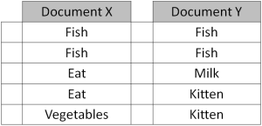
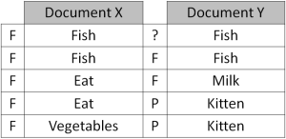
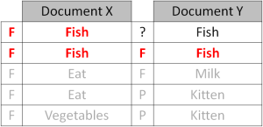
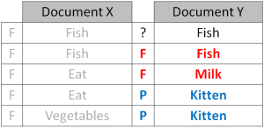
Repeated refinement
The process of checking topic assignment is repeated for each word in every document, cycling through the entire collection of documents multiple times.
This iterative updating is the key feature of LDA that generates a final solution with coherent topics.
Notes:
~10-15min before notebook; notebook as a walkthrough.

Slide 44
12.4 Real world applications
Week 12 Natural Language Processing
Notes:
Run through these after the sentiment analysis notebook. Motivator for future work using NLP.

Slide 45
12.4.1 News article analysis
Week 12 Natural Language Processing

Slide 46
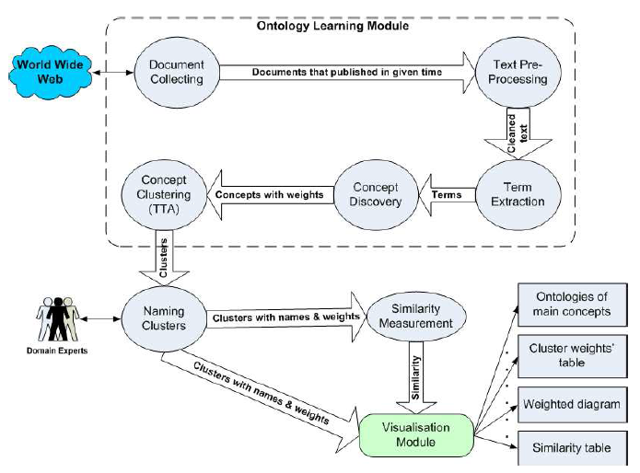
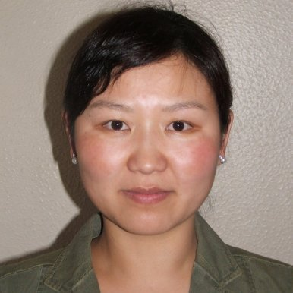
News Topic Evolution
Majigsuren Enkhsaikhan, Wilson Wong, Wei Liu, and Mark Reynolds, 2007

Slide 47
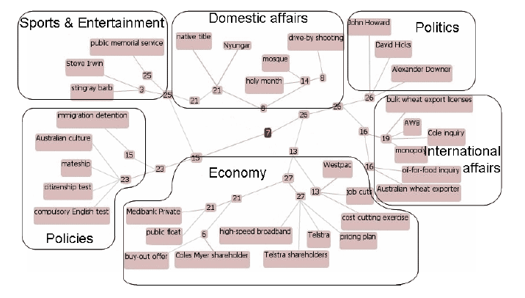
September 2006

Slide 48
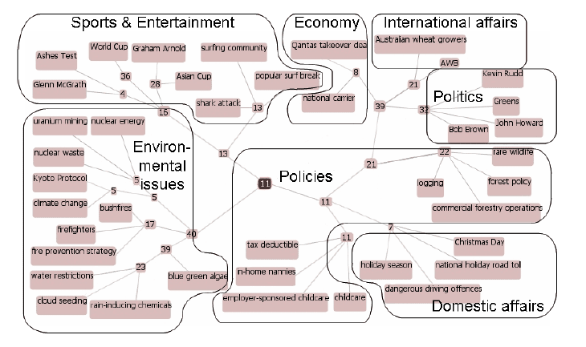
December 2006

Slide 49
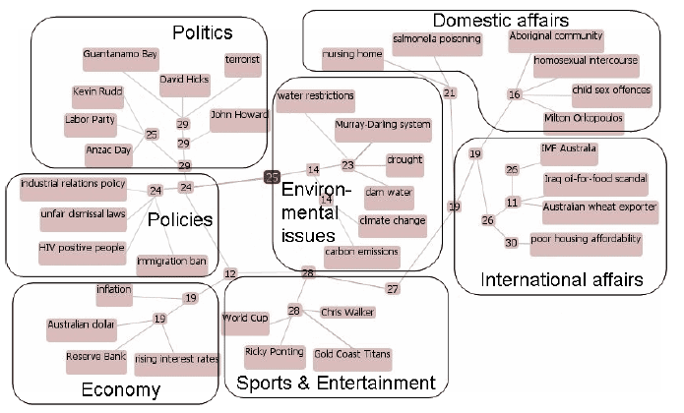
April 2007

Slide 50
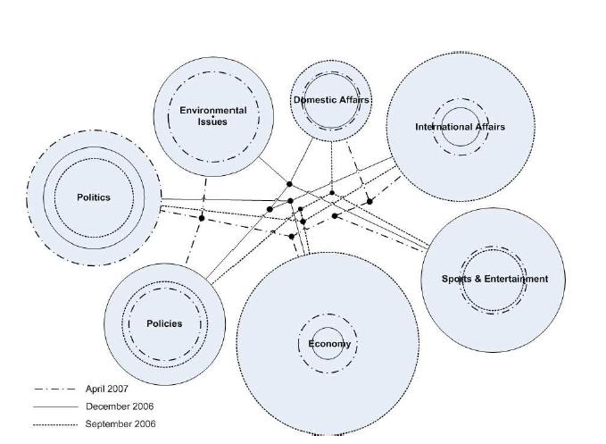
Cluster evolution

Slide 51
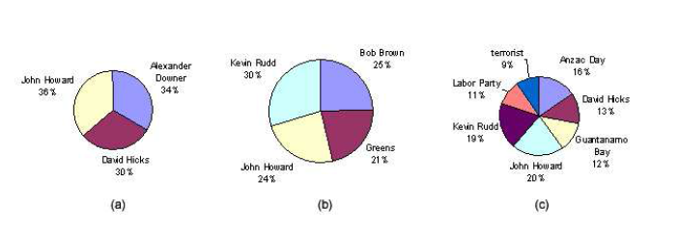
Term Frequency distribution

Slide 52
12.4.2 Medical diagnosis tool
Week 12 Natural Language Processing

Slide 53


Mobile App for Medical Self Diagnosis
Visualisation
Mobile Application
Graph Construction Procedure
Input Data
Graph Database
Additional Data
Machine Learning
Wei Liu, Harrison Sweeney, Bo Chung, & David Glance. (2014).

Slide 54
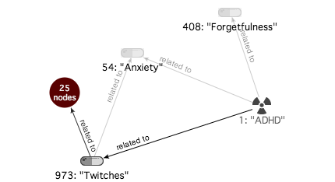
Graph Example 1

Slide 55
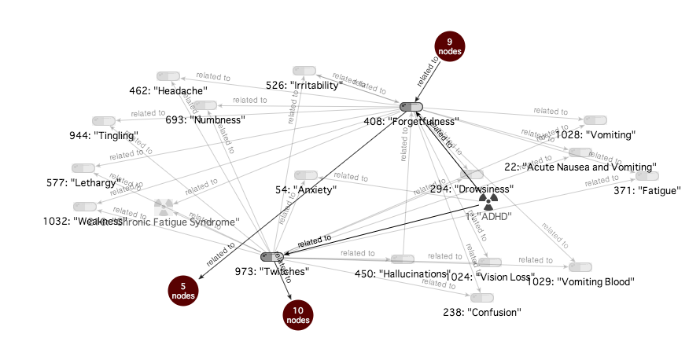
Expended Graph

Slide 56
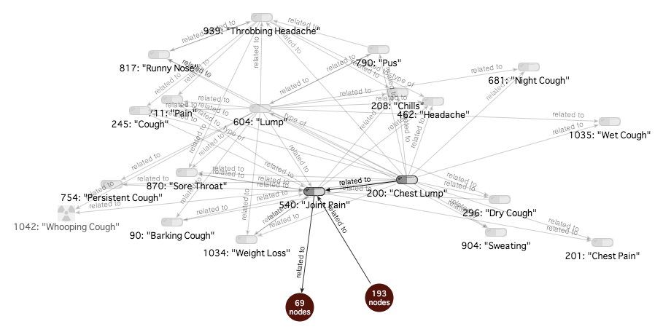
Further Expansion

Slide 57
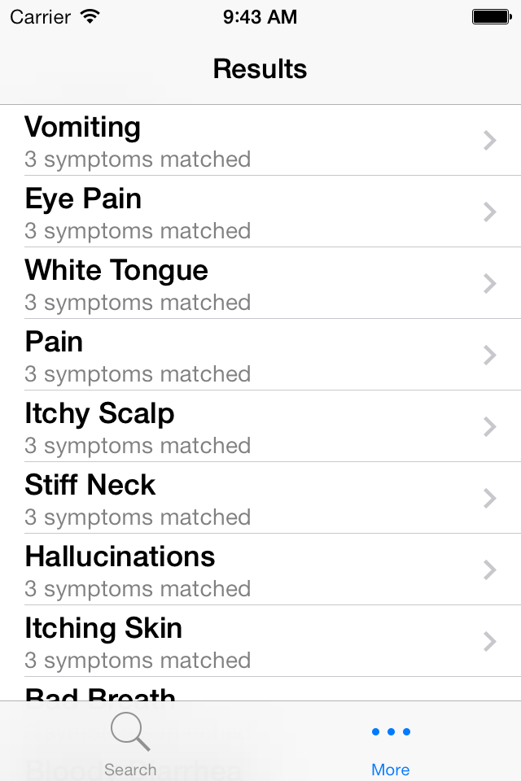

Mobile App
Notes:
An iphone app, left are the symptoms and right is the returned results of possible conditions.

Slide 58
12.4.3 Medical term extraction
Week 12 Natural Language Processing

Slide 59


Wei Liu, Bo Chung, Rui Wang, Nigel Morlet and Jonathon Ng, 2015 (under review)

Slide 60
Medical Term Extraction
An important predecessor step before medical entity recognition, which requires a follow-up step of entity type assignment.
For corpus within a single domain, there is only unit-hood necessary.
Sequence mining technique: PrefixSpan
Hybrid of linguistic and statistical information: CValue
Voting and graph based method: TextRank

Slide 61


Before Filtering (top and bottom 10)

Slide 62


After filtering (top and bottom 10)

Slide 63
12.4.5 pubmed Rank clustering
Week 12 Natural Language Processing

Slide 64


Author Name Disambiguation PubMed
Arvin Varadharajalu, Wei Liu, Wilson Wong. (2011)

Slide 65

NetClus
Yizhou Sun, Yintao Yu, and Jiawei Han. Ranking-based clustering of heterogeneous information networks with star network schema. In Proceedings of the 15th ACM SIGKDD international conference on Knowledge discov- ery and data mining, KDD '09, pages 797-806, New York, NY, USA, 2009. ACM.

Slide 66


Slide 67


Slide 68


Slide 69
12.4.6 gswa survey reports
Week 12 Natural Language Processing

Slide 70


Part-of-Speech Tagging & Grammar Tree
Report
Stanford Dependency Parser
Grammatically parse sentences in each report
Parts of speech (e.g., nouns, verbs, and adjectives)
Relationships between words (e.g., modifiers, compounds)
Dictionary
Build from a variety of geology related resources
General geology dictionary
Schlumberger oilfields glossary
Other web sources (webpages, databased etc)
Clean extracted terms
Lemmatisation
Noise removal
Noun Phrase Chunker
Summary Graphs & Visualisation
Identify noun phrases
Find complete noun phrases, such as ‘Archean greenstone belt’
Document normalising-splitting sentences-noun phrase identification (using Part-of-Speech pattern)
e.g. <NN.*|JJ>*<NN.*> -- Nouns and Adjectives, terminated with Nouns
Merge grammar tree
Merge compound nouns together, keep modifiers
Provides a visual summary of the report
Page Ranking & Key Noun Phrases
Extract key phrases
Keep phrases if they match our dictionary
Provides key phrase summaries of the report
hole, located, drilling, sequence, work, nickel laterite, mapping, exploration, body, range, bif, potential, period, belt, deposit, terrane, amphibolite, mineralisation, …

Slide 71

Analogy Query: kalgoorlie – gold + iron ore Relation: Location:Commodity
Geological term vectors reflect dedicated information for iron ore (location names in WA, names of iron ores)
Pre-trained vectors represent general knowledge
(Middlemount is in Queensland)
martite - a type of iron ore,
marandoo – the Marandoo iron ore mine in the Pilbara region,
hematite - the most important ore of iron,
west angelas - the West Angelas iron ore mine in the Pilbara region,
windarling - Windarling Iron Ore Mine

Slide 72
12.4.7 Maintenance work order processing
Week 12 Natural Language Processing

Slide 73

ARC Training Centre for Transforming Maintenance through Data Science
https://www.maintenance.org.au/

Slide 74
12.4.8 redcoat annotation tool
Week 12 Natural Language Processing

Slide 75


Text Annotation Tool
http://agent.csse.uwa.edu.au/redcoat
Michael Stewart

